Slide 1
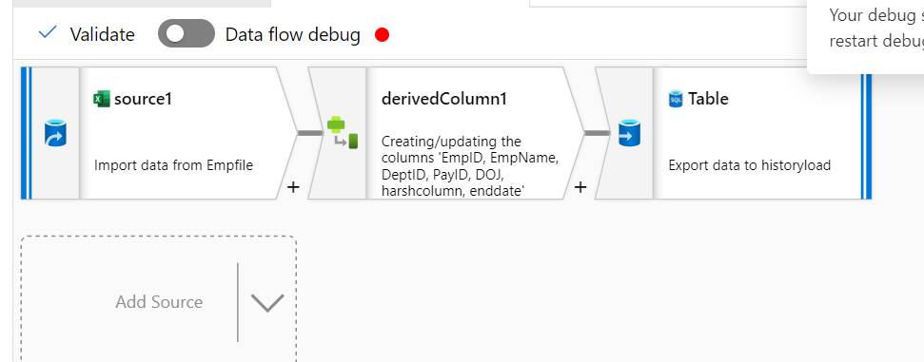
Step:1:Loaded data from input excel to SQL
By taking derived column I have created hash column

Slide 2
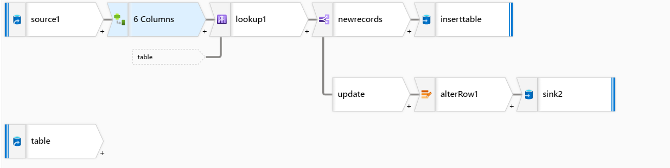
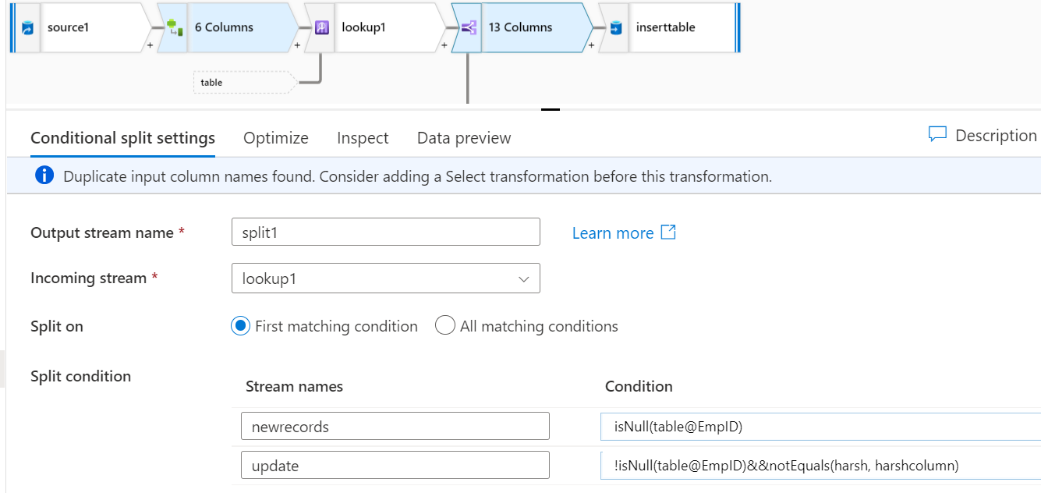
I have created hash column for input file and after that I have taken lookup,there I have taken condition like DimId source= Dimidtable.After that take condition spilting and given the following conditions .

Slide 3
